Slide 1







Advice and
Guidance
(A&G)

Slide 2





What is Advice and Guidance?

Slide 3


A simple explanation:
Sometimes your GP asks a hospital doctor for help. The hospital doctor gives advice so you can get the right care.

Slide 4




How does it work?

Slide 5


1
You see your GP
You go to your GP when you feel unwell or need help.

Slide 6





2
The GP asks for advice
If the GP thinks that specialist input is required, they can ask a hospital doctor for advice.

Slide 7


The hospital doctor looks at your information
3
They read your notes and test results.
They tell the GP what they think will help.

Slide 8


4
Your GP decides what to do
Your GP uses the advice to choose the best care for you. You may get treatment from the GP or be referred for a hospital appointment.

Slide 9



How could A&G
be helpful?

Slide 10

Why A&G could be helpful:
You may get specialist help faster
You may not need to go to the hospital
You may feel less worried
Specialists can give appointments to people in most need
It helps the NHS save time and money

Slide 11

Our findings
on A&G

Slide 12

Our Findings:
  Advice and Guidance (A&G) use has risen a lot, especially during and after the COVID‑19 pandemic.
People from less deprived areas and white ethnic groups are more likely to have A&G used in their care.

Slide 13

Our Findings:
  A&G does not necessarily replace a referral. Most patients who receive A&G (about 9 out of 10) also have a direct referral to a specialist around the same time.
Clinicians use A&G for different reasons (for example, to get quick advice or support), so it is not always used
an alternative to being referred.

Slide 14

Our Findings:
  A&G works differently in different hospitals and specialties.
While it can be very helpful for patients’ healthcare journeys, improvements in how services are organised can help ensure it is used safely, effectively, and fairly.

Slide 15


Want to gain a better understanding?
BADGER study:
https://www.keele.ac.uk/research/ourresearch/medicine/researchareas/primarycare/badger/
NHS England:
https://www.england.nhs.uk/elective-care/
best-practice-solutions/advice-and-guidance/
Or scan our QR:

Slide 16



Slide 17
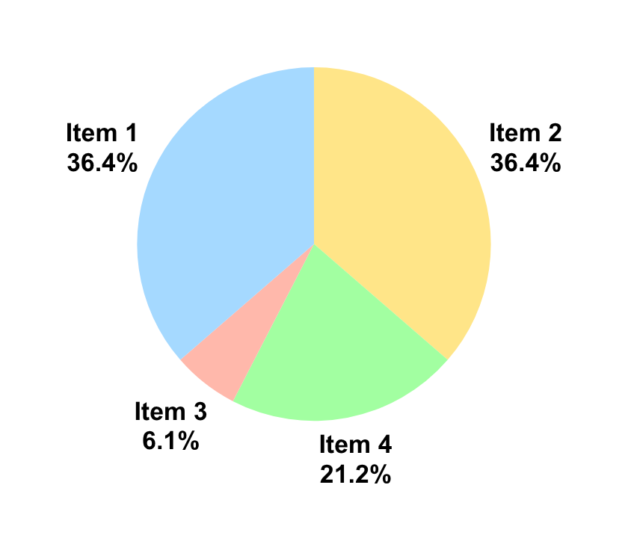
Our Findings:
Item 1:
Ipstum 36.4% preguntal camona te
Sub-heading:
Item 2:
36.4% fa comes onaji
Item 3:
Lorre 6.1% ca khabi sans
Item 4:
A ton 21.2%
The data reflets that Advice and Guidance...

